Slide 4
Notes:
Video URL: https://videos.pexels.com/video-files/2257256/2257256-hd_1920_1080_24fps.mp4

Slide 5
Notes:
Video URL: https://videos.pexels.com/video-files/2792370/2792370-hd_1920_1080_30fps.mp4

Slide 10
Notes:
Video URL: https://videos.pexels.com/video-files/3129671/3129671-uhd_3840_2160_30fps.mp4

Slide 14
Notes:
Video URL: https://videos.pexels.com/video-files/3255275/3255275-uhd_3840_2160_25fps.mp4

Slide 17
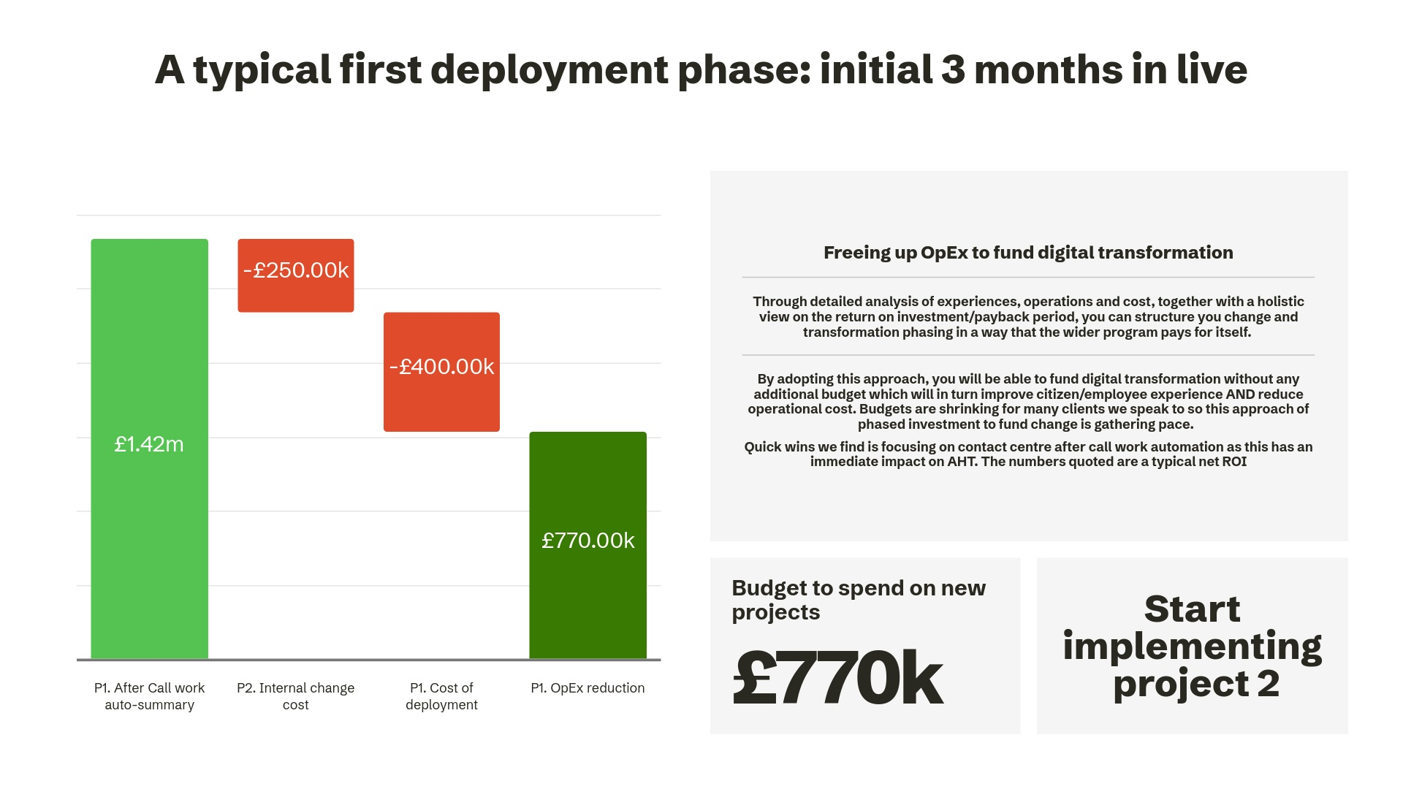

Slide 19
Notes:
Video URL: https://videos.pexels.com/video-files/1793414/1793414-hd_1280_720_30fps.mp4

